Slide 1

PECUNIA BANKING MANAGEMENT SYSTEM

Slide 2
Team Members
K. Shashankan(Team Leader)
K. Sai Nivas(Team Member)
Rajeev(Team Member)
J. Venu(Team Member)
Goverdhan Reddy(Team Member)

Slide 3
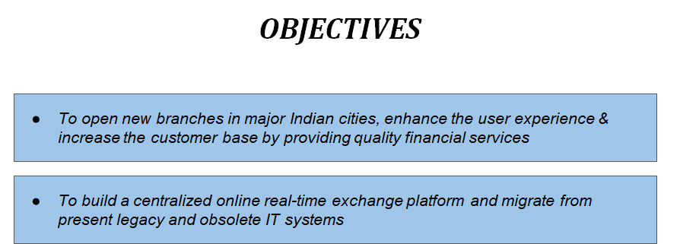

Slide 4
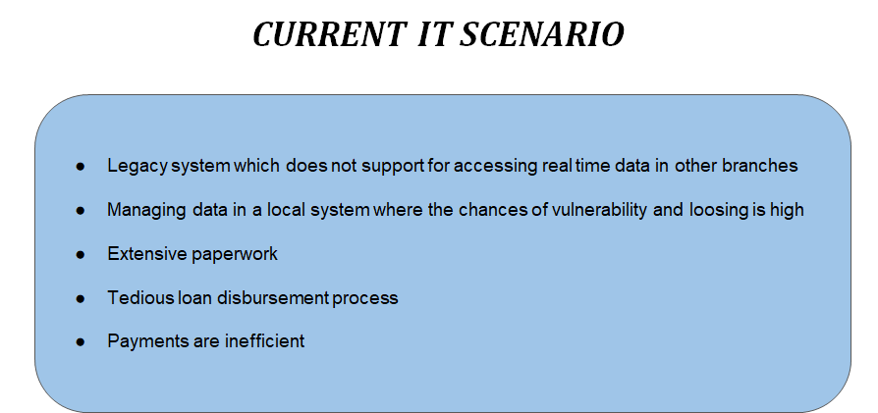

Slide 5
Functional Requirements | Non-Functional Requirements
Account Management | Application must support for 100 branches
Transaction Management | All canned reports should be published in <10 sec
Loan Management | All ad-Hoc reports should be published in <5 sec
Passbook Maintenance | Generation of customer passbook in <5 sec

Slide 6
Technologies Used For Project
Back-end: Spring Boot
Front-end: Angular
Testing: JUnit(Automatic testing)
Postman(Manual Testing)
Selenium (BDD Testing)

Slide 7
CLASS DIAGRAM

Slide 8
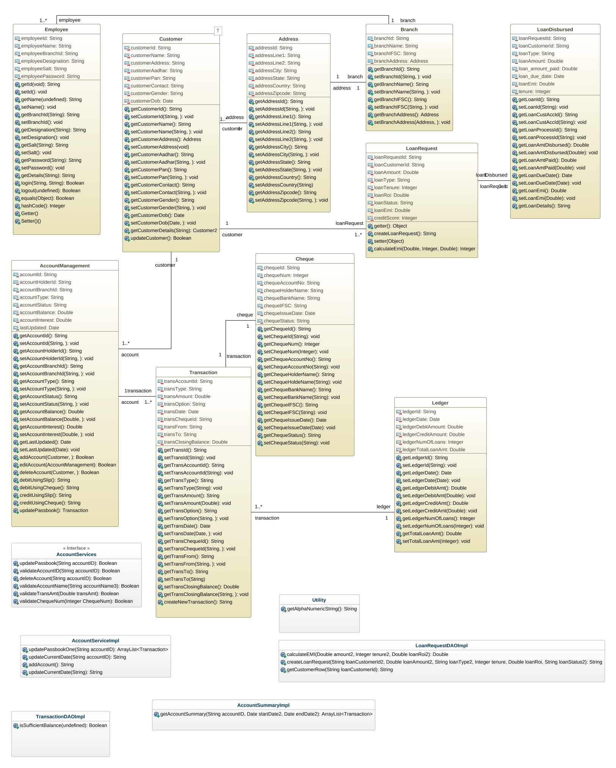

Slide 9
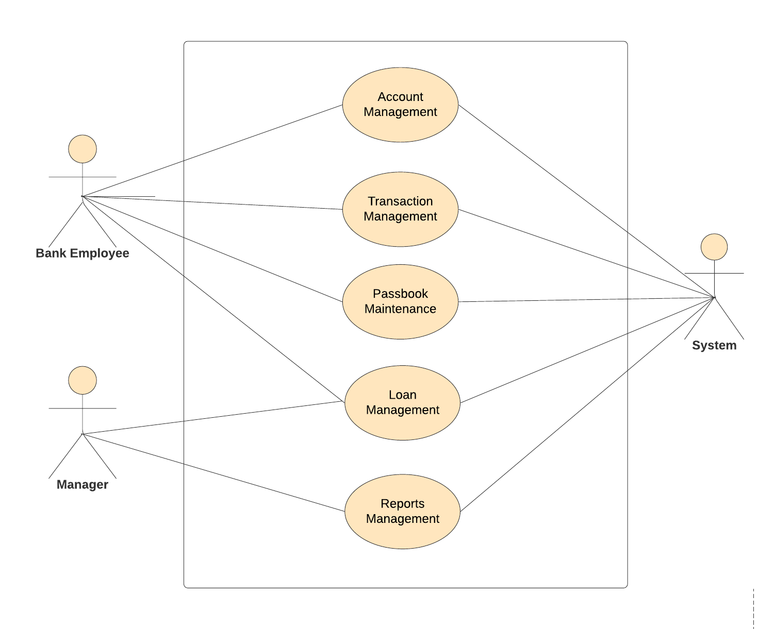
Overview Use Case Diagram

Slide 10
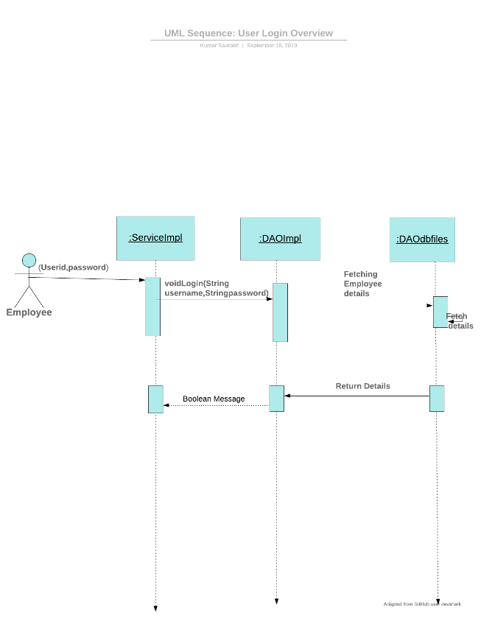
Login Sequence diagram

Slide 11
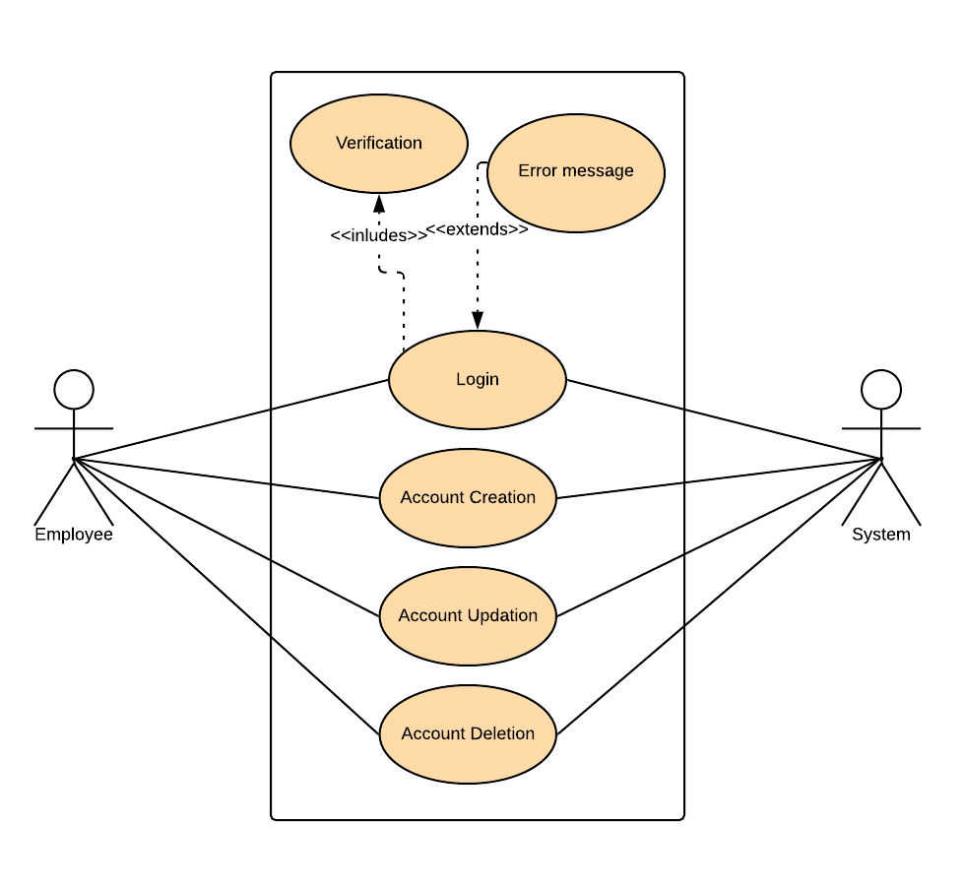
Account Management Use Case

Slide 12
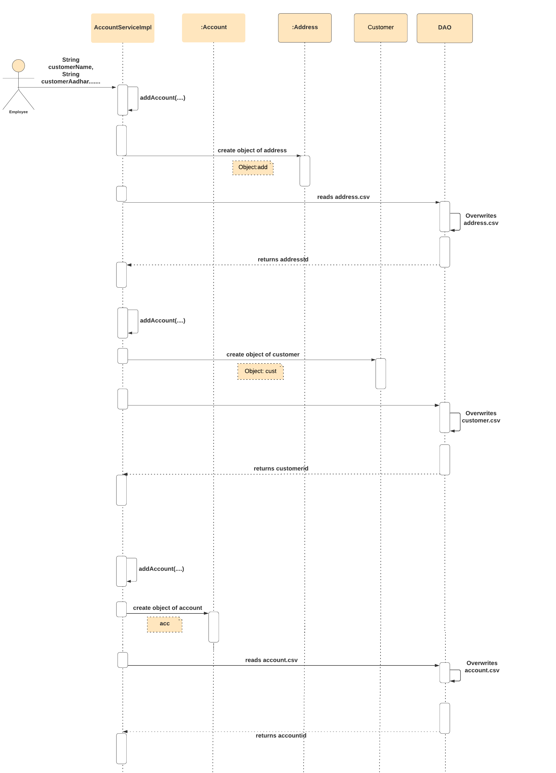
Account Creation Sequence Diagram

Slide 13
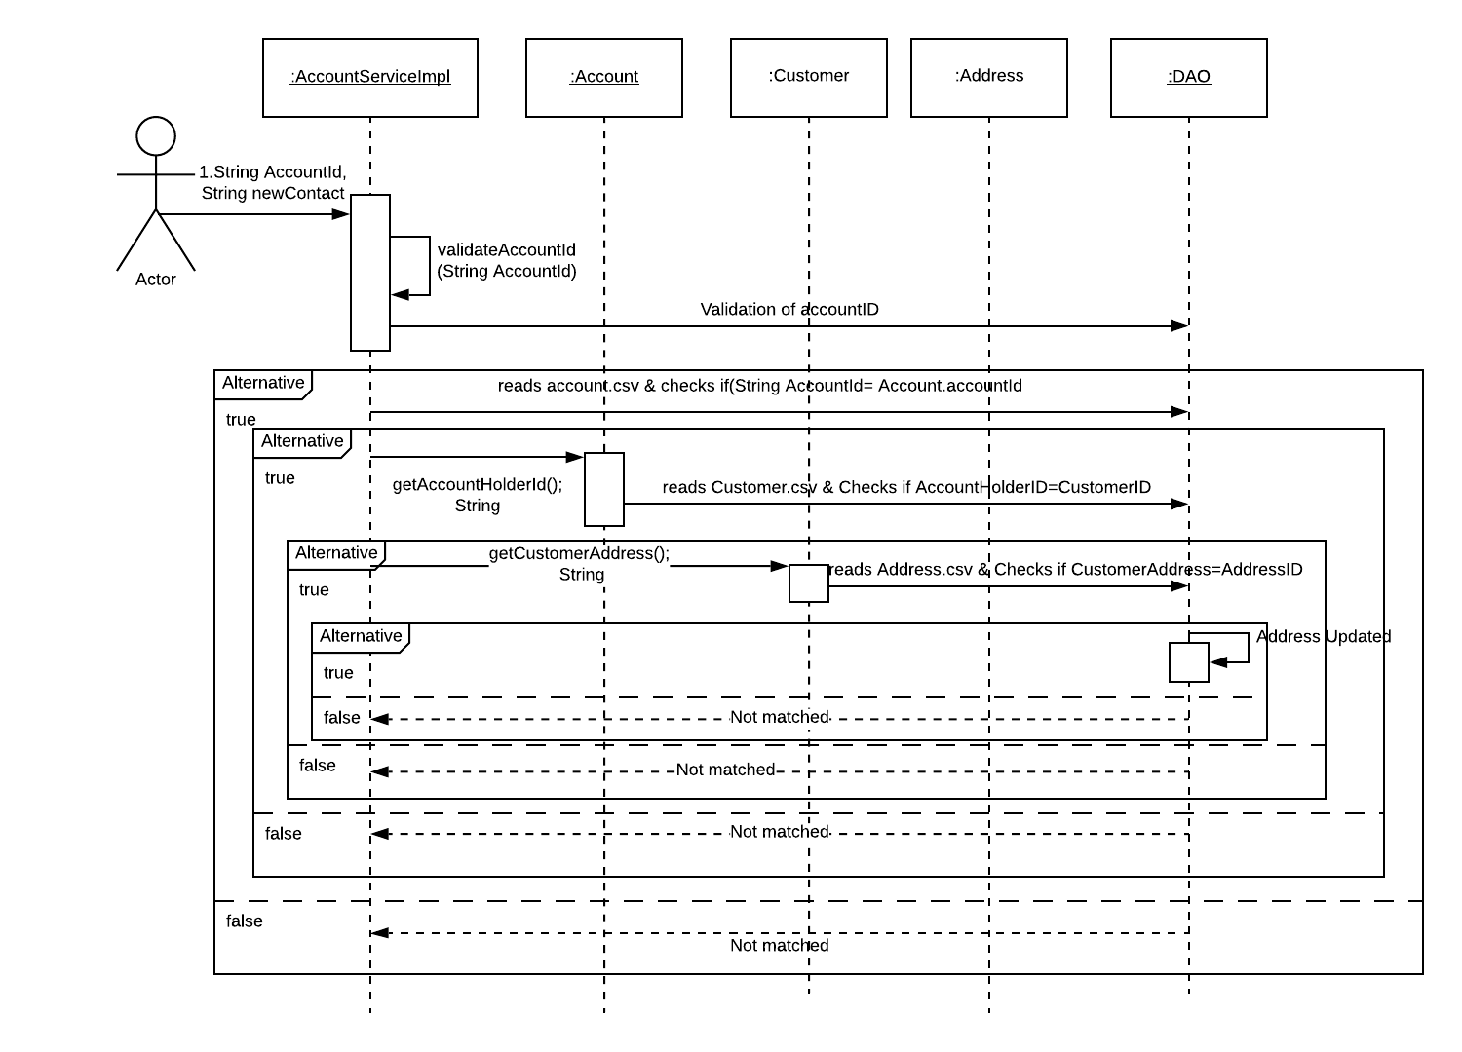
Account update Diagram

Slide 14
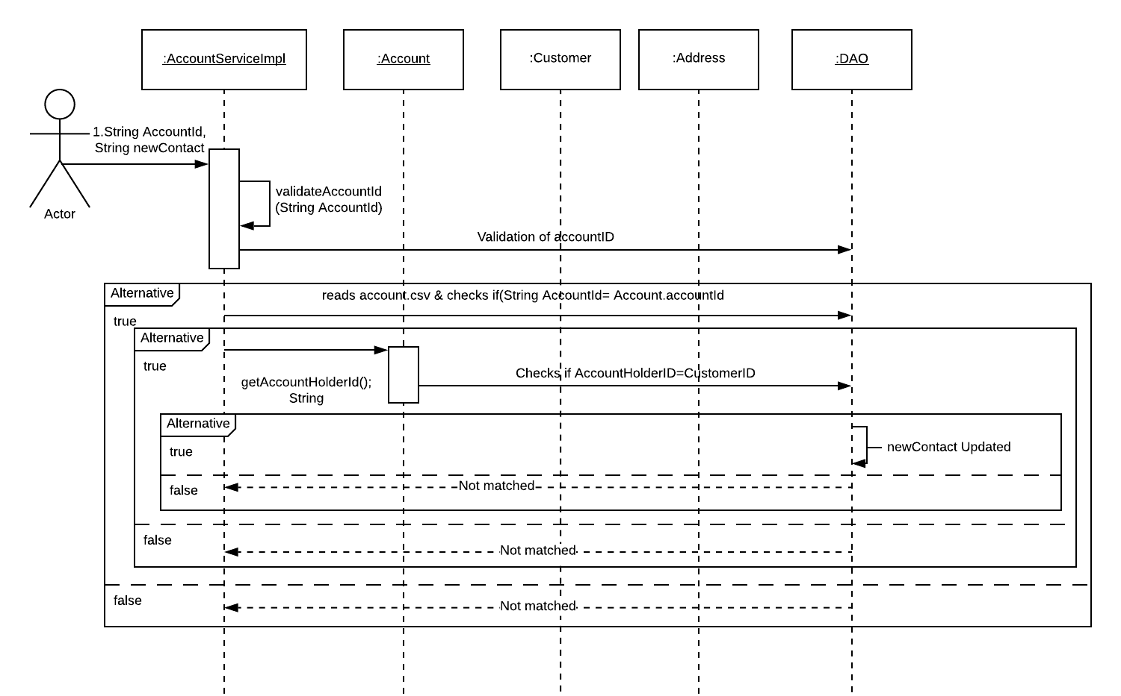
Account update Diagram
(continued)

Slide 15
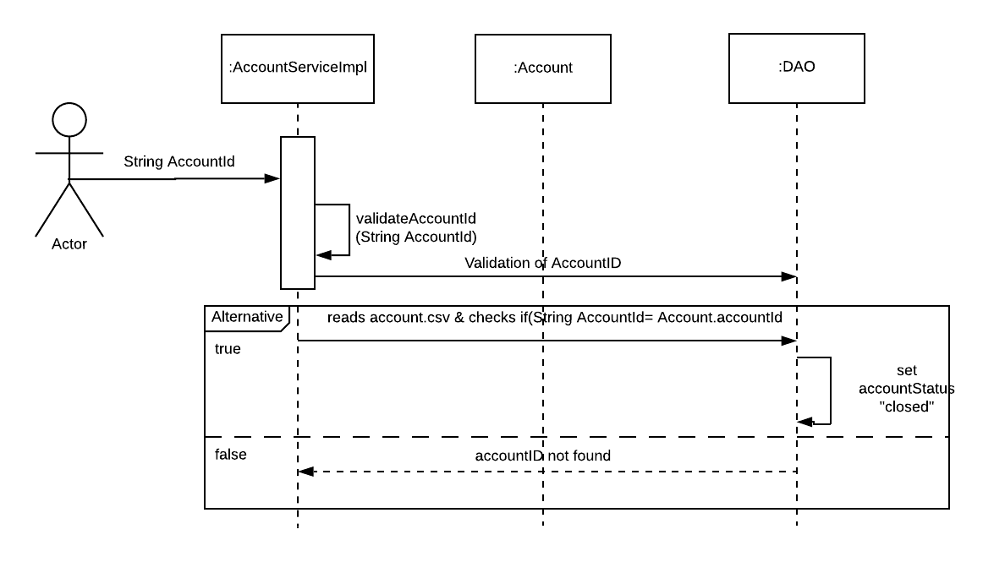
Account Deletion Sequence diagram

Slide 16
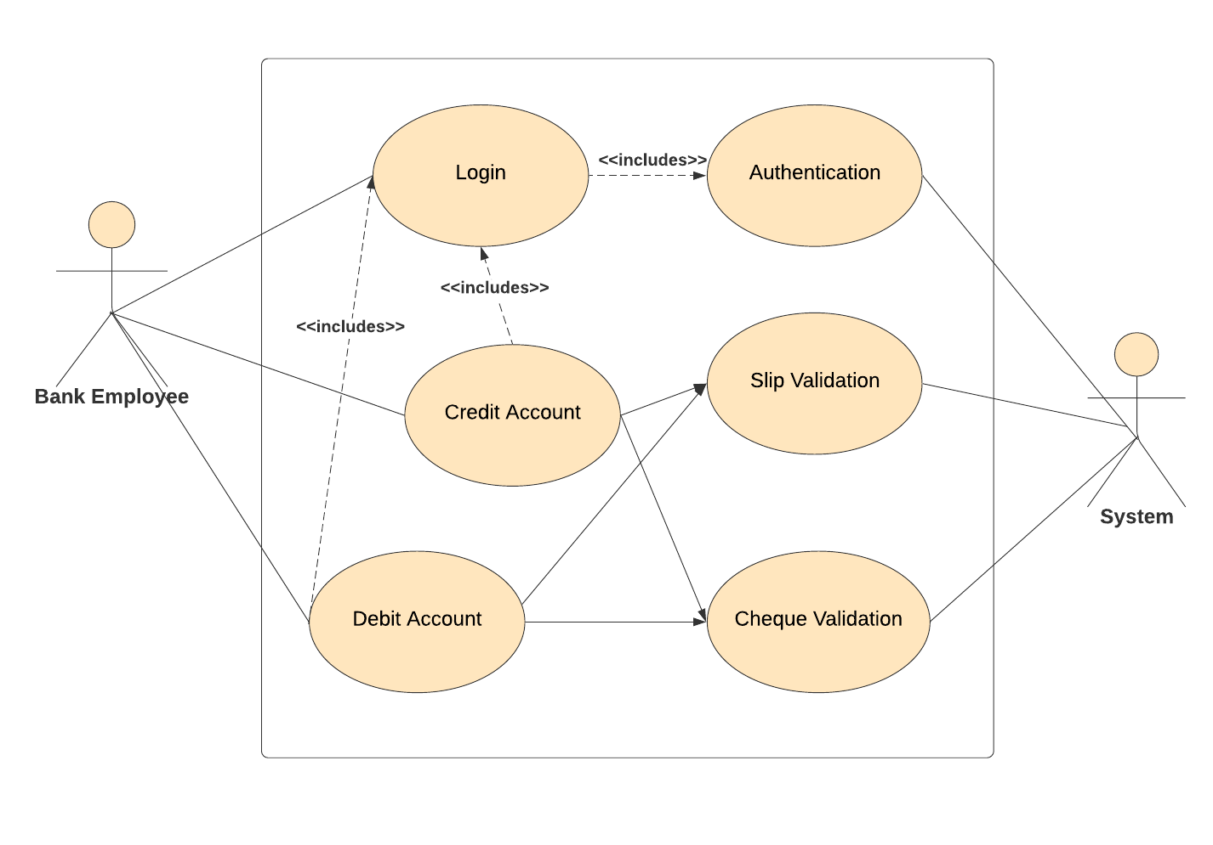
Payment Use Case Diagram

Slide 17
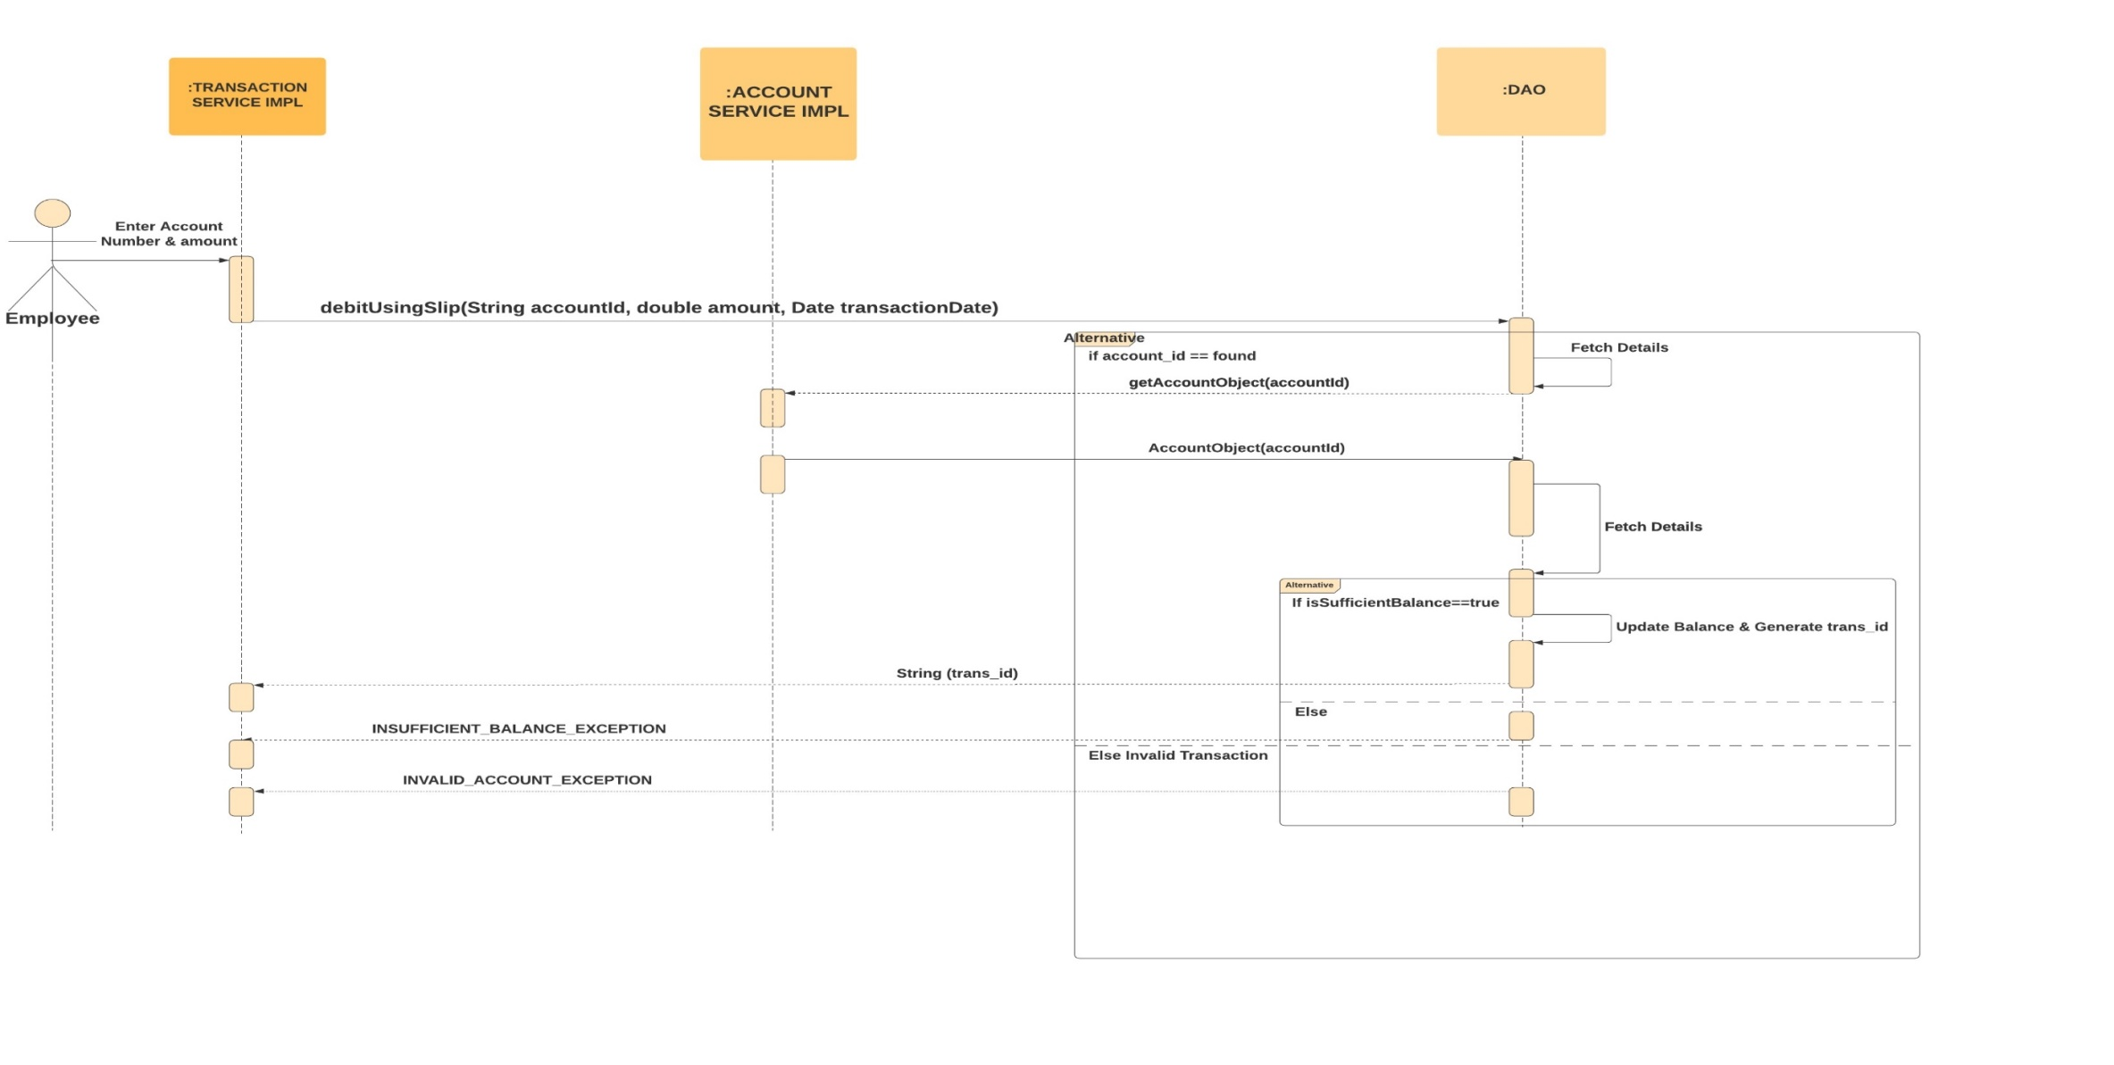
Payment Sequence Diagram debit using slip

Slide 18
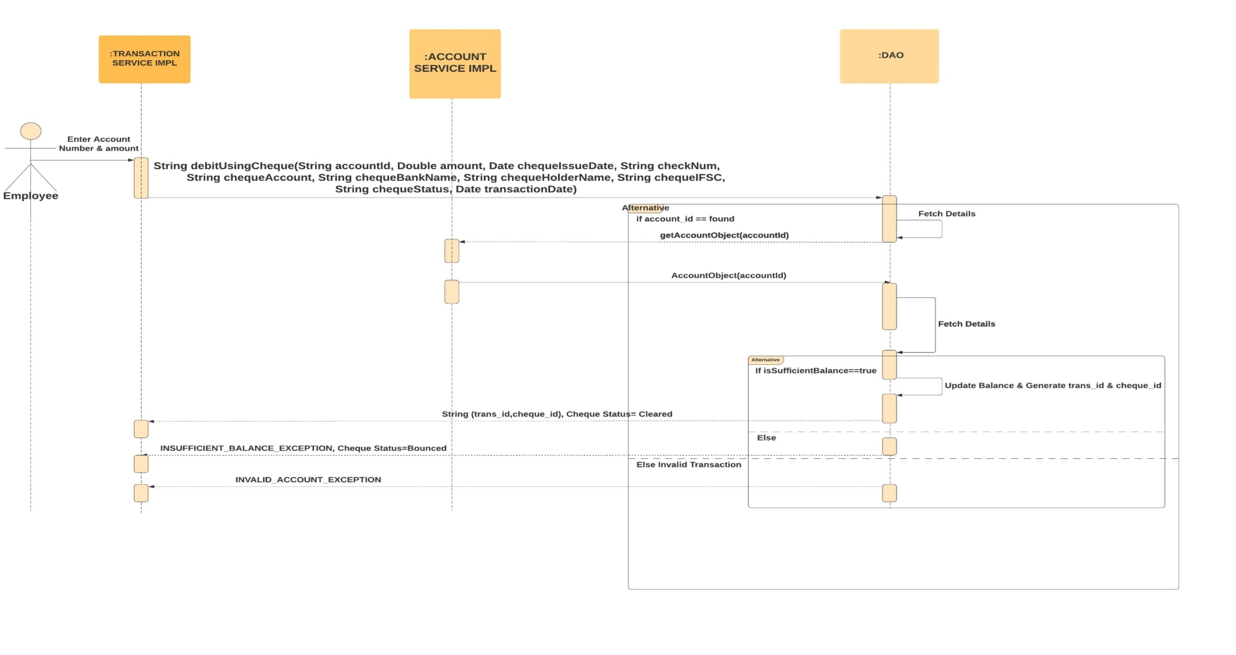
Payment Sequence Diagram Debit using cheque

Slide 19
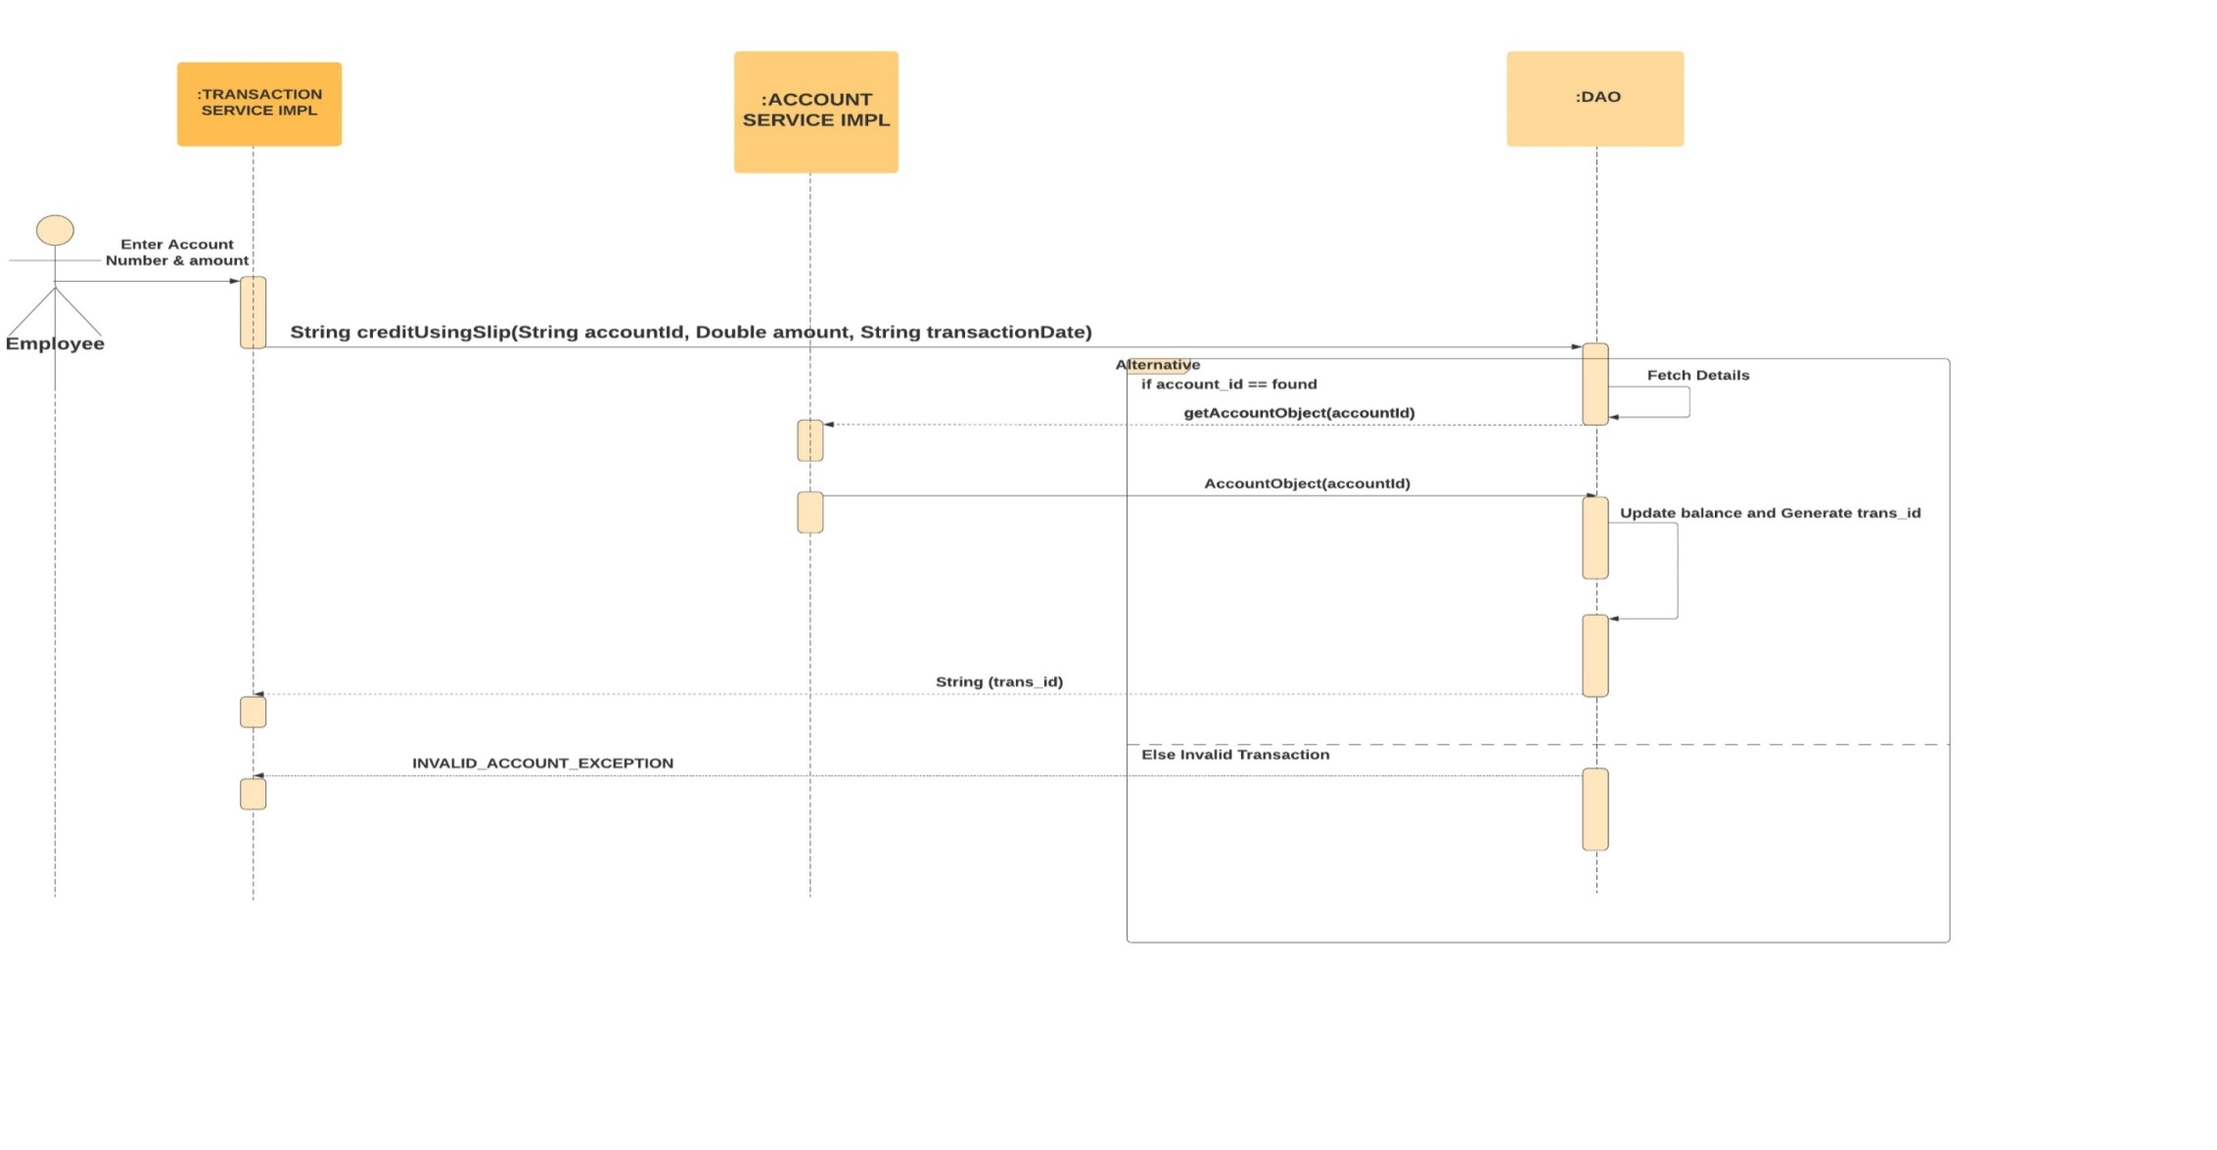
Payment Sequence Diagram credit using slip

Slide 20
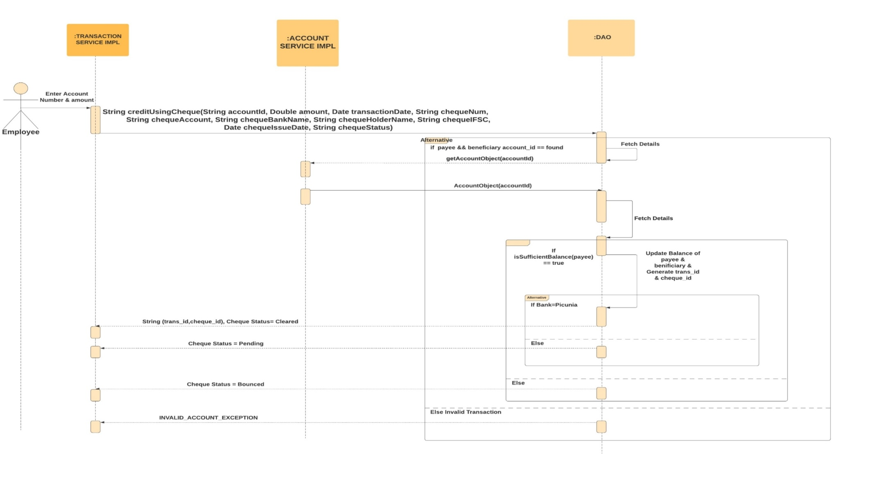
Payment Sequence Diagram Credit Using cheque

Slide 21
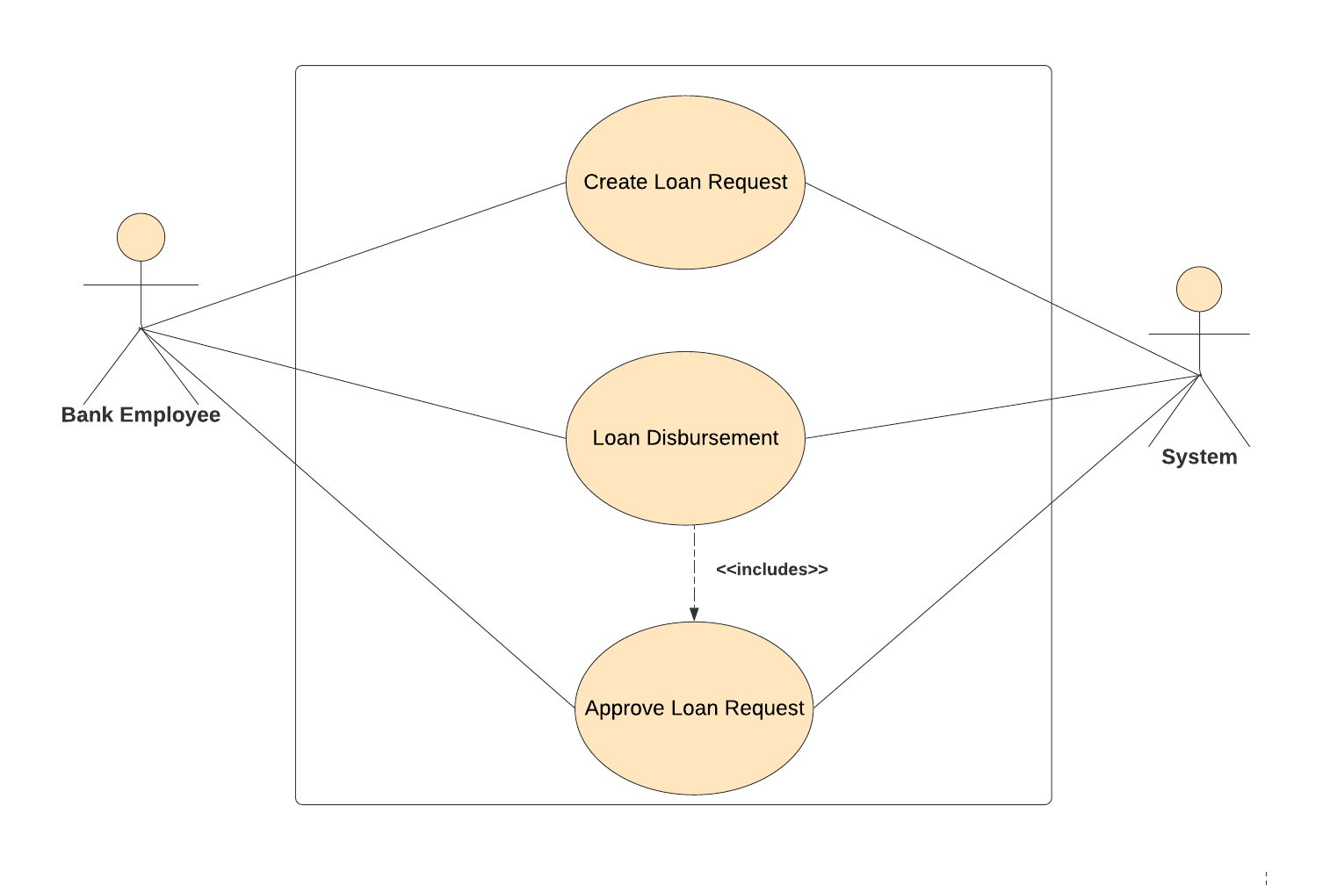
Loan Use Case Diagram

Slide 22
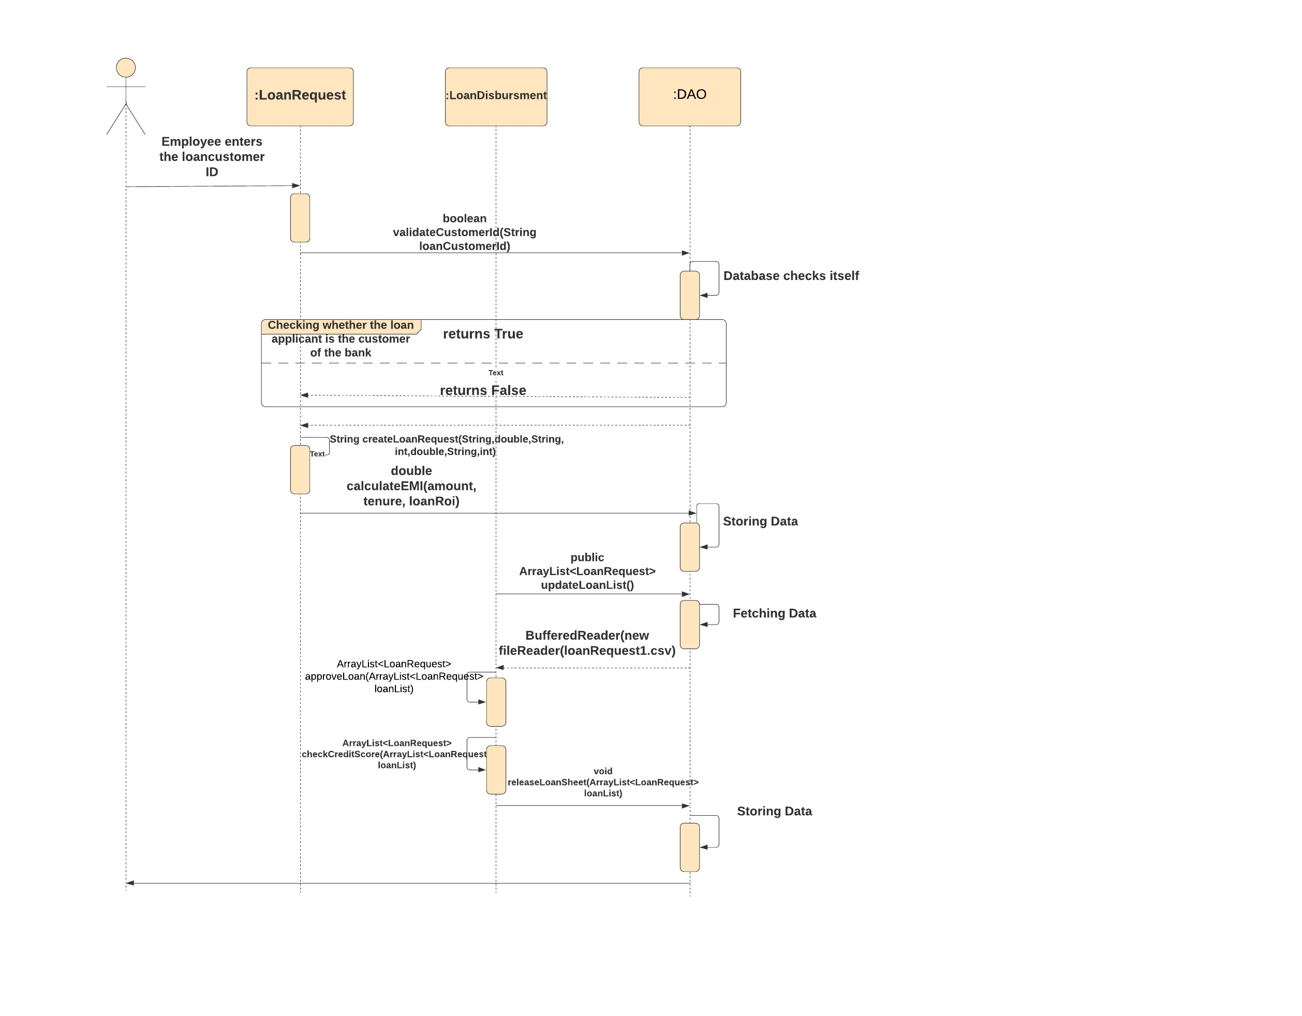
Loan Sequence Diagram

Slide 23
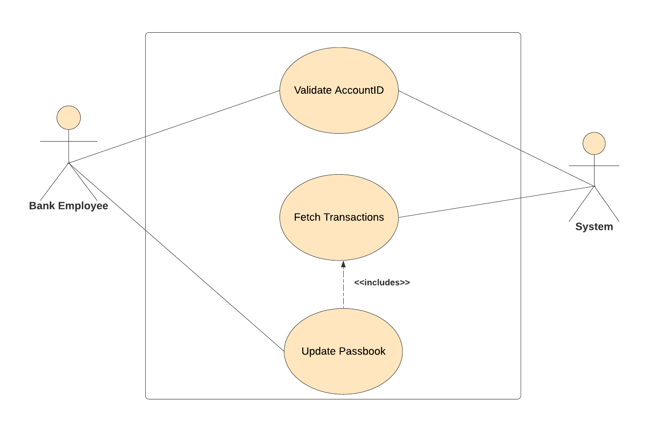
Use case diagram for passbook

Slide 24
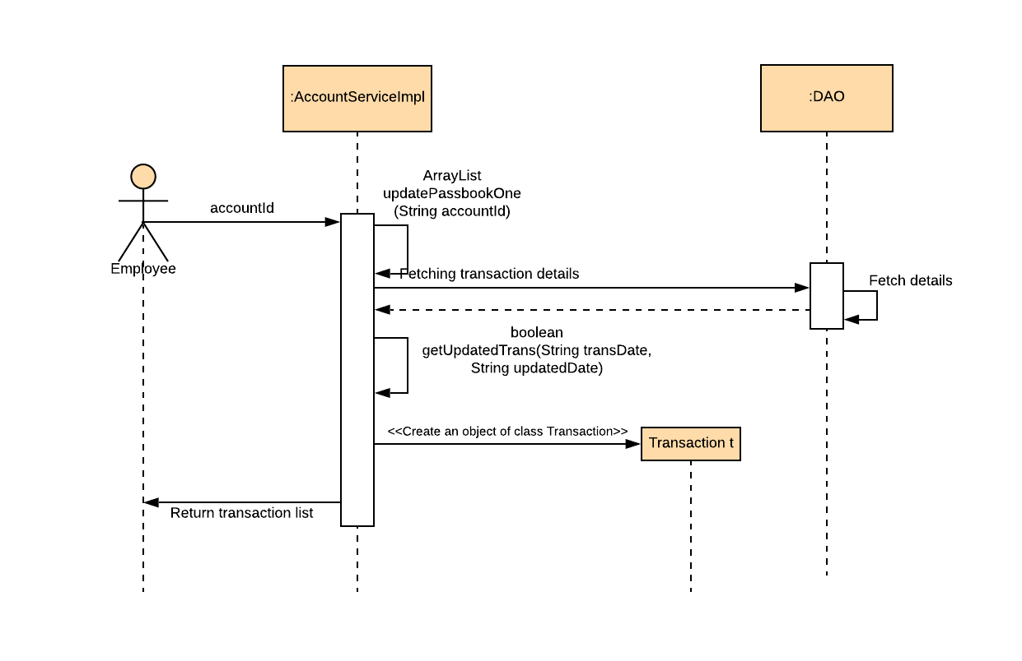
Passbook Sequence Diagram

Slide 25
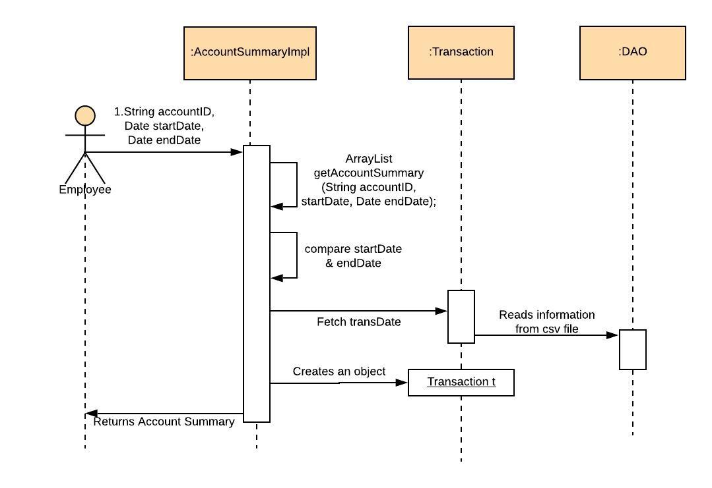
Passbook Sequence Diagram

Slide 26
THANK YOU!😊

